Slide 1

Computer Architecture
Course Code: CSE360
Lecture 13
Micro-programmed Control

Slide 2
Microinstructions
An alternative to a hardwired control is a microprogrammed control unit, in which the logic of the control unit is specified by a microprogrm
Microprogram (or firmware) consists of a sequence of instructions in a microprogramming language. These are very simple instructions that specify micro-operations
Microprogram is midway between hardware and software
How can we use the concept of microprogramming to implement a control unit?

Slide 3
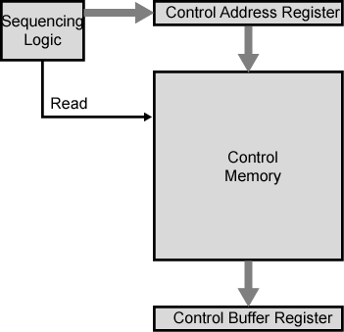
Microprogrammed Control Unit
Key elements of instructions:
The set of microinstructions is stored in the control memory
The control unit register contains the address of the next microinstruction to be read
When a microinstruction is read from the control memory, it is transferred to a control buffer register
Sequencing unit loads the control address register and issues a read command

Slide 4
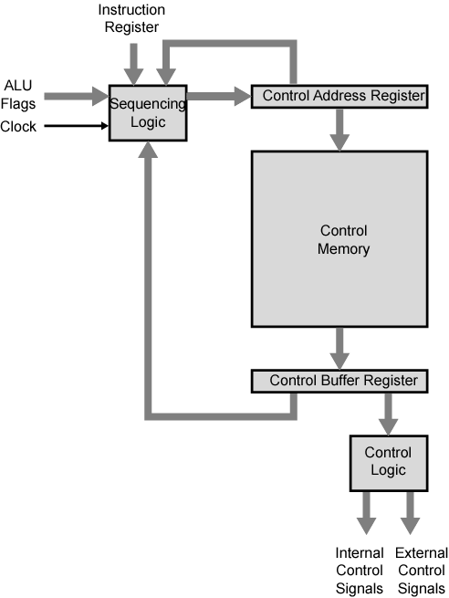
Control Unit Organization
Let us examine the control unit structure in detail
Control unit has same inputs (IR, ALU, flags, clock) and outputs (control signals)

Slide 5
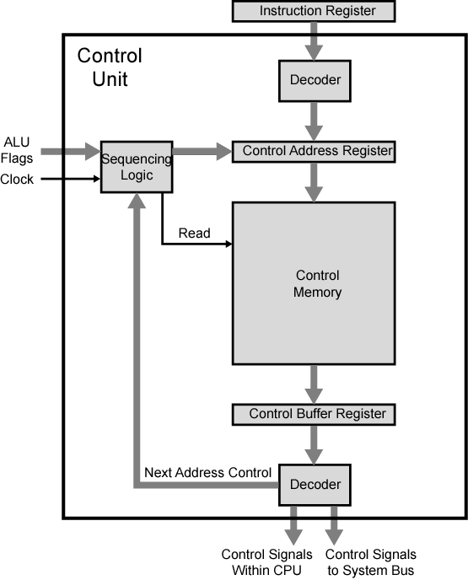
Functioning of Microprogrammed
Control Unit

Slide 6
Control Unit Function
To execute an instruction, the sequencing logic unit issues a READ command to control the memory
The word address is specified in the control address register is read into control buffer register
Control buffer register generates control signals and next address information for the sequencing logic unit
Sequence logic unit loads new address into control address register based on the next address information from control buffer register and ALU flags
All this happens during one clock pulse

Slide 7
Next Address Decision
Sequencing logic unit loads new address into control address register depending on ALU flags and control buffer register. One of three decisions is made:
  Get next instruction
    Add 1 to control address register
  Jump to new routine based on jump microinstruction
    Load address field of control buffer register into control address register
  Jump to machine instruction routine
    Load control address register based on opcode in IR

Slide 8
Sequencing Techniques
Based on current microinstruction, condition flags, contents of IR, control memory address must be generated
Based on format of address information
  Two address fields
  Single address field
  Variable format

Slide 9
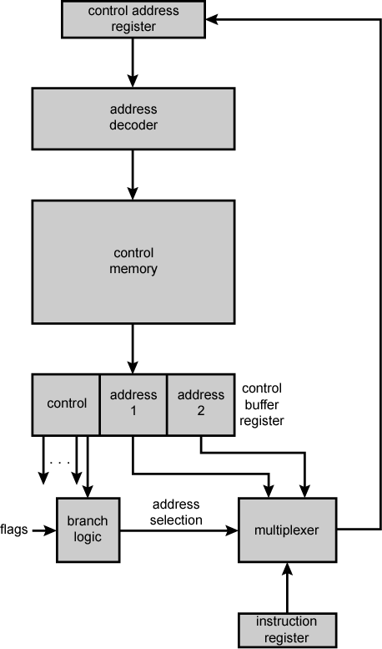
Branch Control Logic:
Two Address Fields
A multiplexer is provided that serves as a destination for both address fields plus the instruction register
Based on an address-selection input, the multiplexer transmits either the opcode or one of the two addresses to the CAR
CAR is subsequently decoded to produce the next microinstruction address
The address selection signals are provided by a branch logic logic module whose input consists of flags and bits from control unit portions

Slide 10
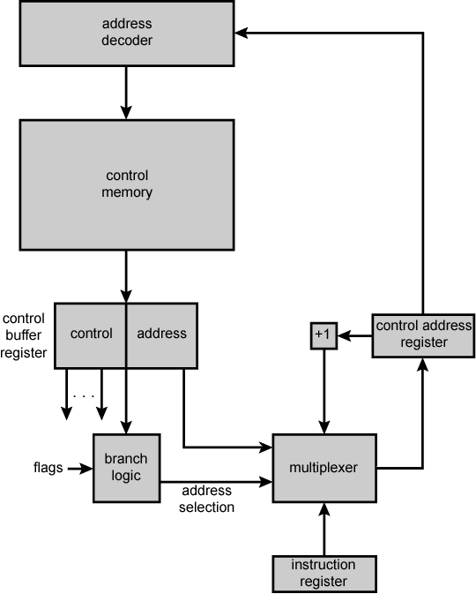
Branch Control
Logic: Single
Address Field
Two address approach is simple, it requires more bits in the microinstruction than other approaches
With some additional logic, savings can be achieved
A common approach is to have a single address field
With this approach, the options for the next address are
- Address field
- Instruction register code
- Next sequential address
The address selection signals determine which option is selected
This approach reduces the number of address fields to one

Slide 11
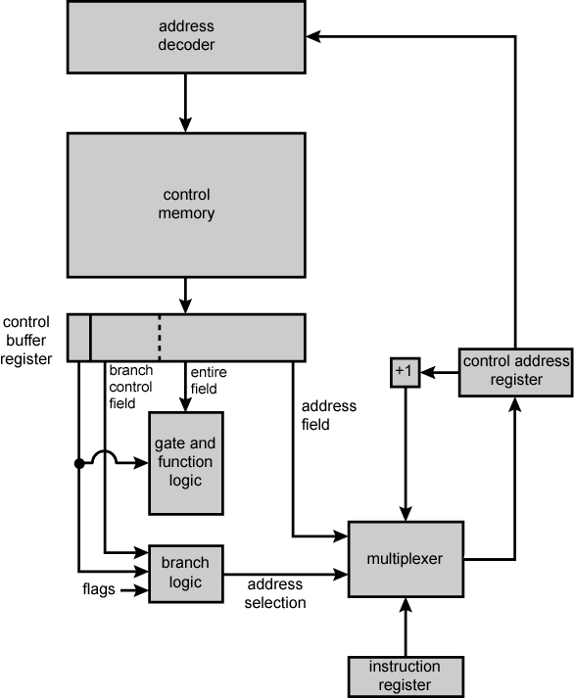
Branch Control
Logic: Variable
Format
This approach is to provide for two entirely different microinstruction formats
In one format, the remaining bits are used to activate control signals
In other format, some bits drive the branch logic module and the remaining bits provide the address
With the first format, the next address is either the next sequential address or an address derived from the instruction register
With the second format, either a conditional or unconditional branch is being specified

Slide 12
Control Unit
Organization
The sequencing logic generates the address of the next microinstruction, using as inputs the instruction register, ALU flags, control address register (for incrementing), and control buffer register
The module is driven by a clock that determines the timing of the microinstruction cycle
The control logic generates control signals

